Slide 1
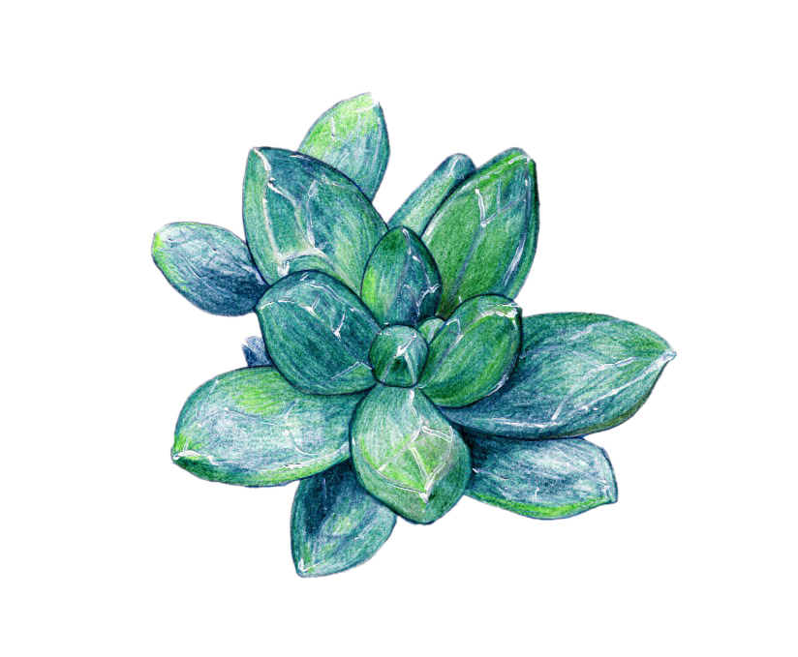






Leaf Disease Detection and Cure using Deep-Learning
Presented By:
Rumana Begum
And Team

Slide 2


Agenda
Introduction
Abstract
Problem Statement
Proposed System
Methodology
Hardware Requirements
Software Requirements
Modules
System Architecture
Snapshots
Conclusion
References

Slide 3
INTRODUCTION
Agriculture is the main source of food, raw material, and fuel which contributes to the economic development of a nation.
Food security remains threatened by various circumstances including climate change, the decline in pollinators, crop diseases, lack of irrigation, etc.
In this work, specific CNN architectures were trained and assessed, to form an automated plant disease detection and diagnosis system, based on simple images of leaves of healthy and diseased plants.

Slide 4
ABSTRACT
The basic deep learning tool used in this work is Convolutional Neural Networks (CNNs).
CNN is a type of artificial neural network, which is widely used for image/object recognition and classification.
Our objective is to construct a system that takes images as input, and after precise testing, it gives the disease name along with its description and cure in the output.

Slide 5
PROBLEM STATEMENT
Traditionally, diseases in plants is detected by visual inspection of plant tissue by trained agriculture experts.
However , manual detection methods are no longer suitable with rapid development of agriculture, especially in large-planting areas.
Visual observation by experts may give different individual solutions.

Slide 6
PROPOSED SYSTEM
The CNN-based leaf disease identification model is capable of distinguishing between healthy and diseased leaves.
CONTAINS:
Deep Learning:
Deep learning (also known as deep structured learning) is part of a broader family of machine learning methods based on artificial neural networks with representation learning.

Slide 7
PROPOSED SYSTEM
CONTAINS:
MobileNet:
MobileNet is a simple but efficient and not very computationally intensive convolutional neural networks for mobile vision applications. MobileNet is widely used in many real-world applications which includes object detection, fine-grained classifications, face attributes, and localization.
3. Dataset:
Datasets are needed at all stages of image analysis study, from training to evaluating algorithms. In this work we have taken several healthy and diseased leaves images belonging to 38 classes.

Slide 8
Methodology:
Choosing a Dataset
Prepare the dataset for training
Input the training set into MobileNet V1 architecture
Compilation
Save the model in model.h5
Accuracy and score of the model
Prediction

Slide 9
HARDWARE REQUIREMENTS
Processor: Intel i5 3.0 GHz
RAM: 8 GB and above
System type: 64-bit Operating system
Hard disk: 500 GB

Slide 10
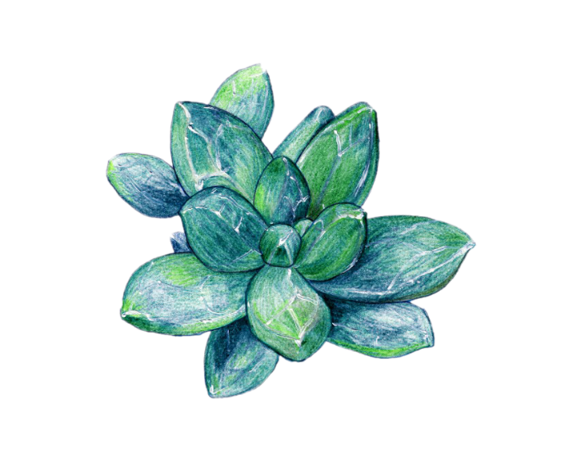
SOFTWARE REQUIREMENTS
Operating system: Windows 10 or more
Programming Language: Python
Library: Matplotlib, numpy, Pandas, Sckit-learn, Tensorflow, Keras, Joblib, Scikit-Image.
Simulation tool: Anaconda Navigator IDE 3.7.4, (jupyter Notebook), Brackets and Python 3.8.

Slide 11
MODULES
Modules in the proposed model are as follows:
1. Data Pre-processing
2. Feature extraction
3. Training
4. Classification and Prediction

Slide 12
PRE-PROCESSING
Before feeding the images into the proposed structure, a pre-processing step is performed. The first process is to downsize the original image from 512 × 512 pixels into 224 × 224pixels in order to decrease dimensionality.
Data is divided into three sections; training, validation, and test sets all with their individual target labels.

Slide 13
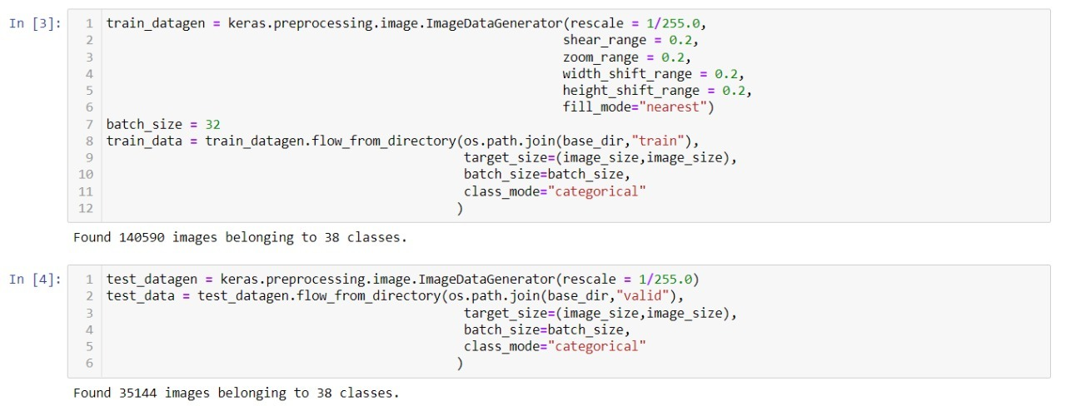
PRE-PROCESSING

Slide 14
2. FEATURE EXTRACTION
The key role of feature extraction in leaf disease detection is to learn the features automatically. Mostly, the attributes such as shape, texture, and colour of plant leaf images are utilized to detect leaf infections.
Feature extraction block provides a vector of features that extracts individual characteristics of each sample.
In this stage, the important features required for image classification are extracted.

Slide 15
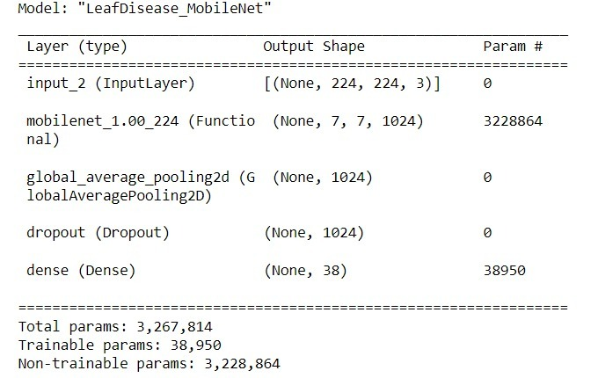
2. FEATURE EXTRACTION

Slide 16

3. TRAINING
The model is trained using a dataset containing images of healthy and diseased leaves.
The model serves its objective by classifying images of leaves into diseased categories based on the pattern of the detect.

Slide 17
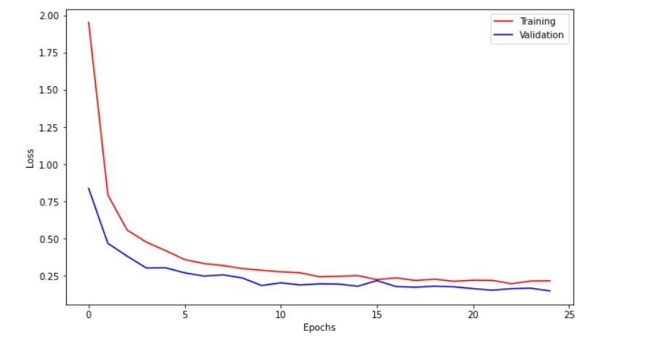
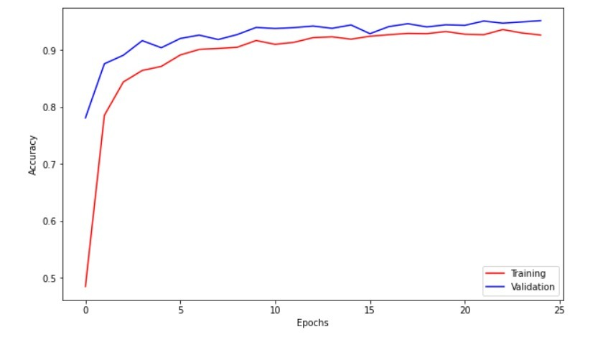
3. TRAINING

Slide 18
4. CLASSIFICATION AND PREDICTION
On the basis of the trained data sets model will classifies the input image into different categories.
The maximum classified categories is retuned as output.
If the leaf is healthy it will display, ‘leaf is healthy’. Else it will display name of the disease.
Also it will display the cause and treatment to cure that disease.

Slide 19

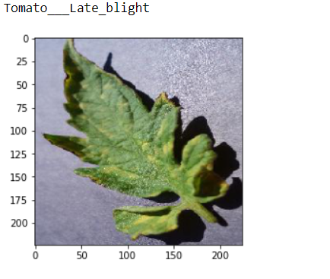

4. CLASSIFICATION AND PREDICTION

Slide 20
SYSTEM ARCHITECTURE
RESULT
IMAGE DATASET
PREDICTION
RGB COLOUR IMAGE
TESTING
DISEASE TRAINING
DATA AUGMENTATION
TRAINING
Training Parameter
Augmented data
DISEASE DETECTION
VALIDATION
Deep learning Algorithm

Slide 21
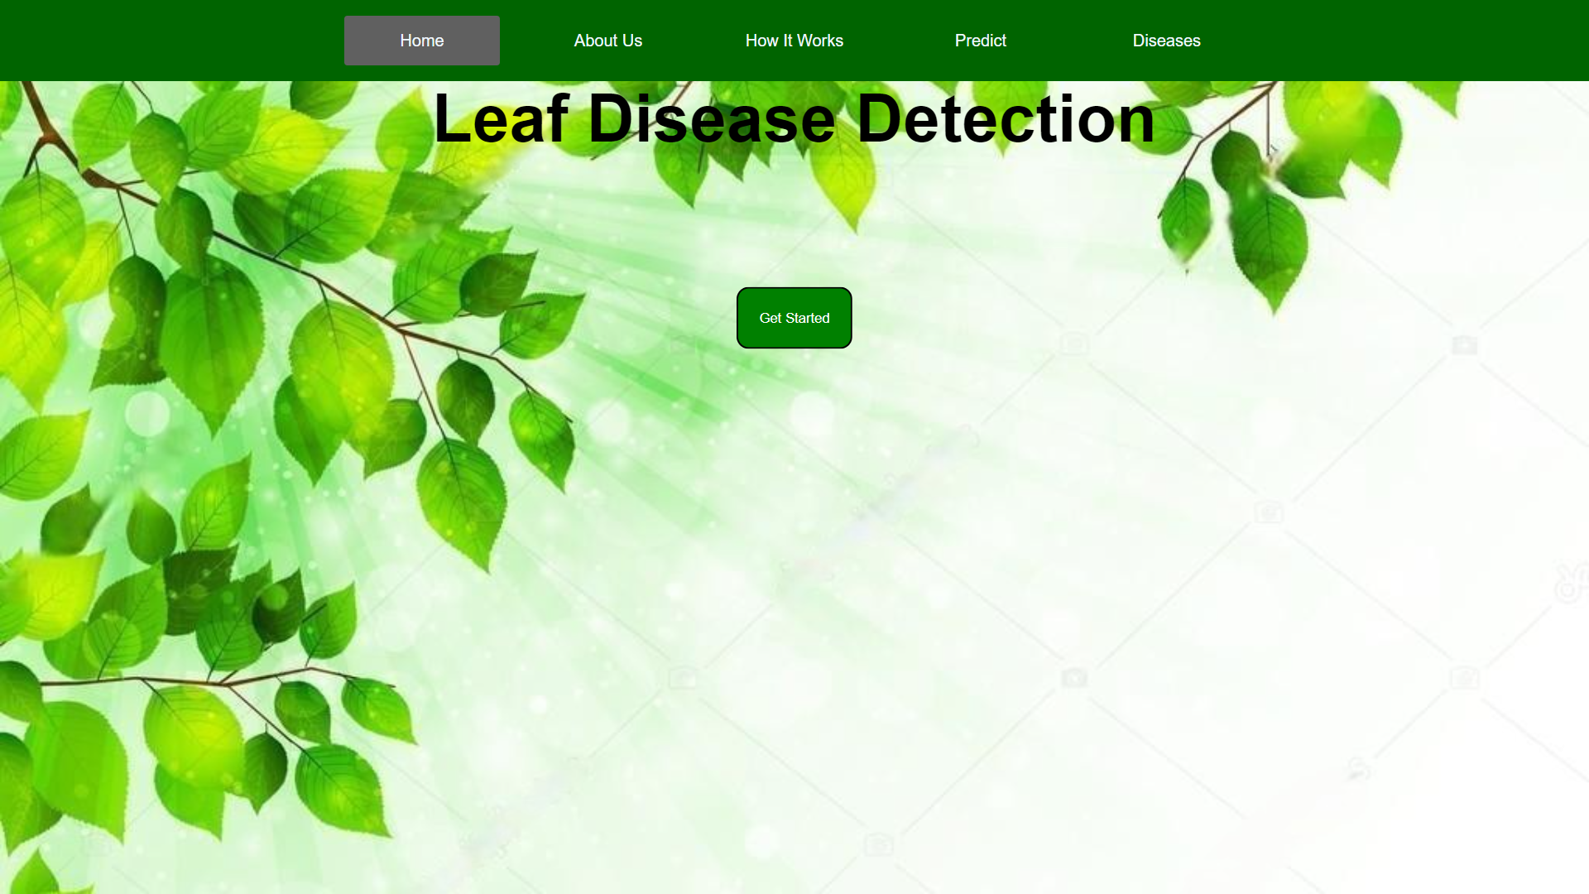
Snapshot of home page

Slide 22
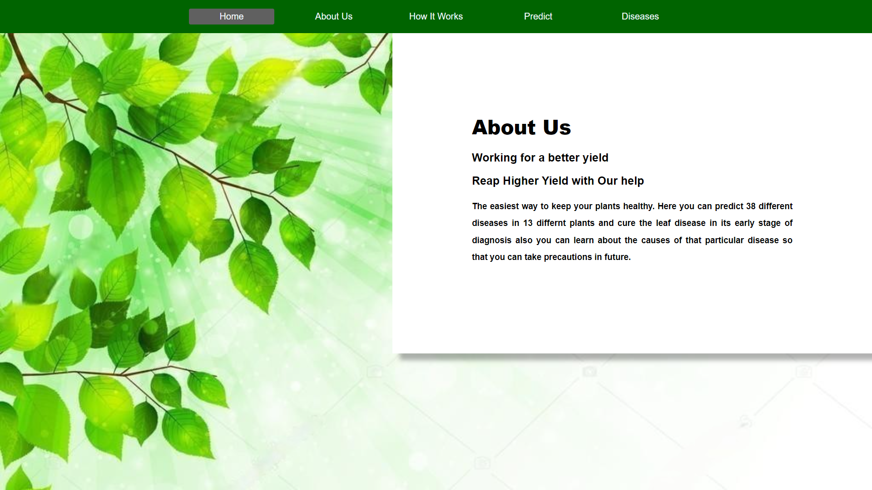
Snapshot of AboutUs page

Slide 23
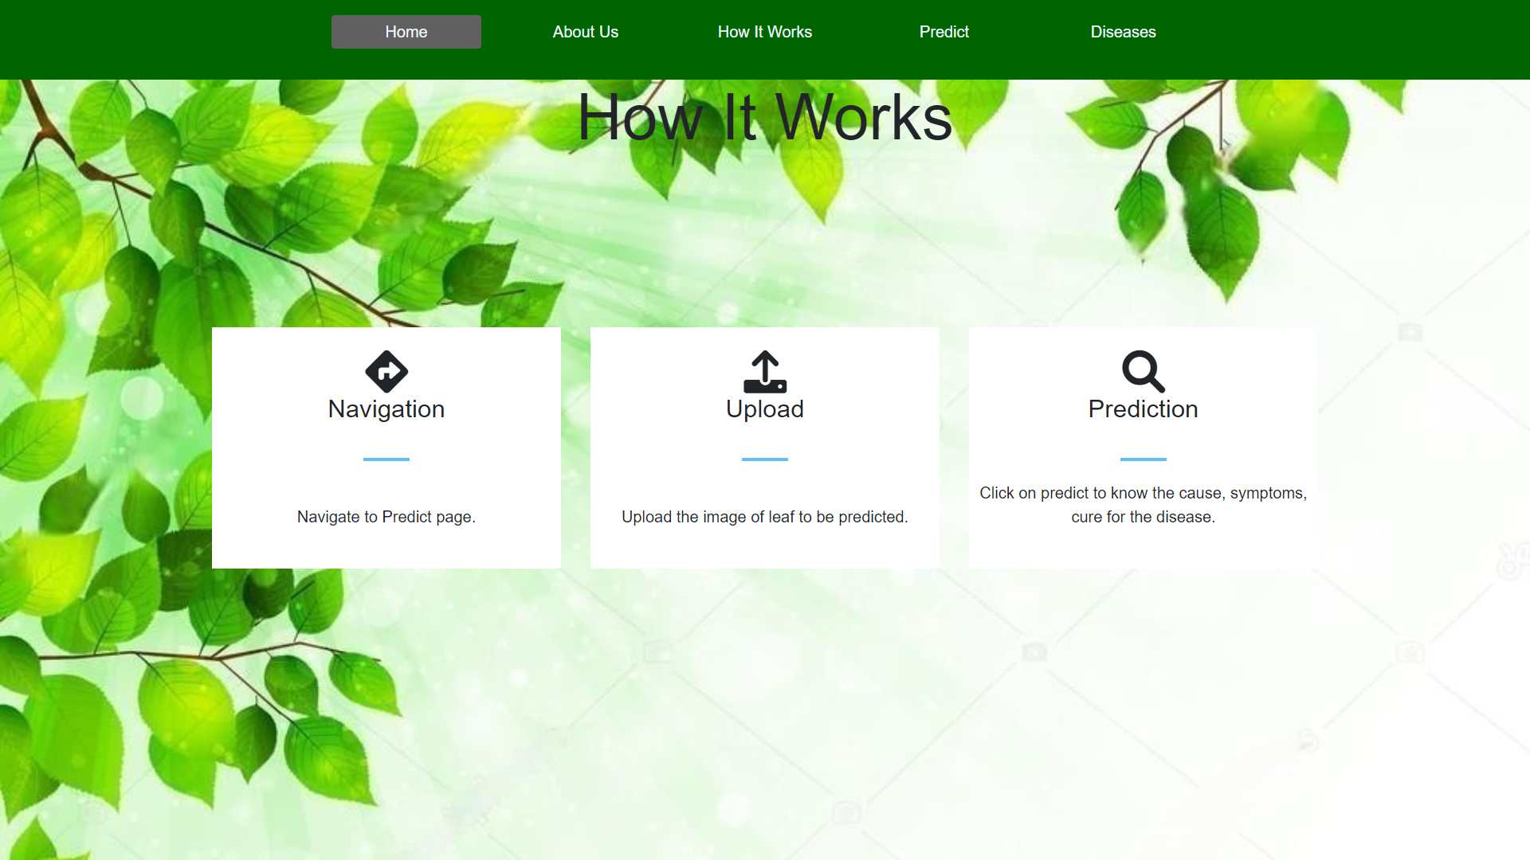
Snapshot of How It Works page

Slide 24
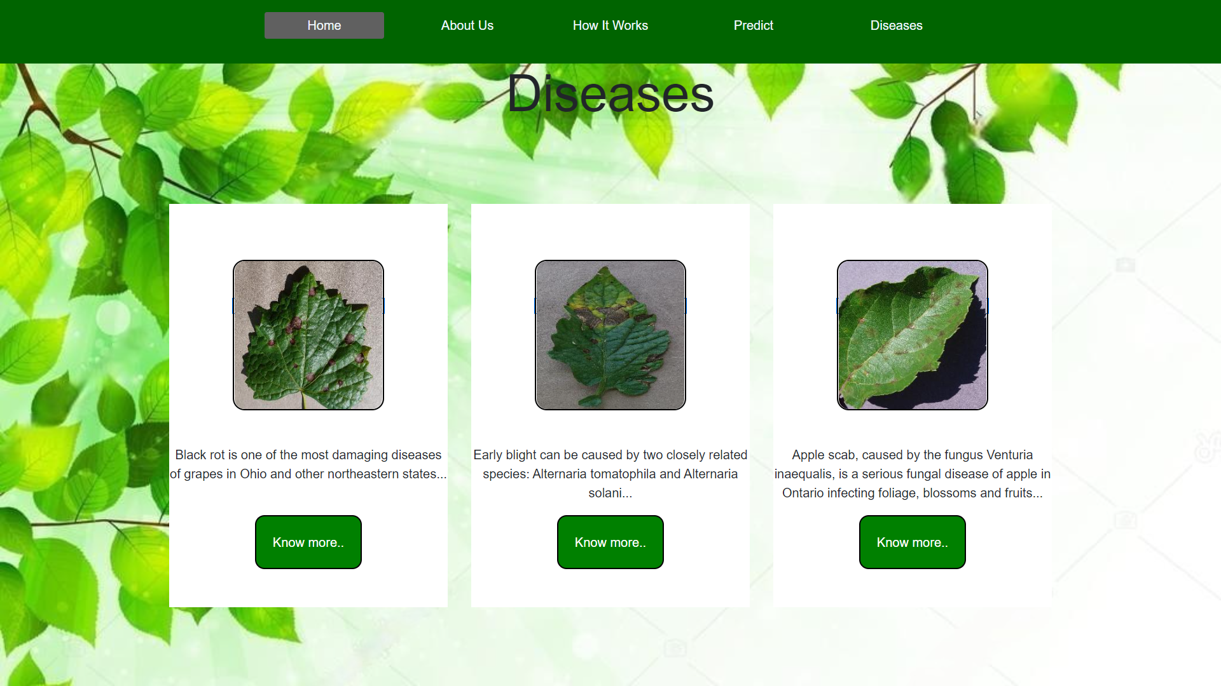
Snapshot of Diseases page

Slide 25
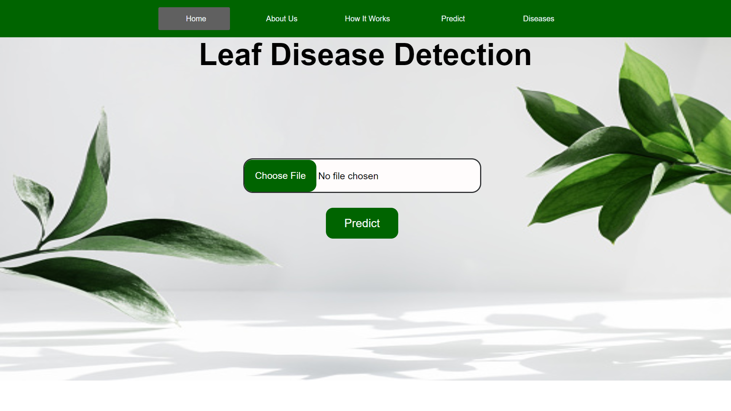
Snapshot of index page

Slide 26
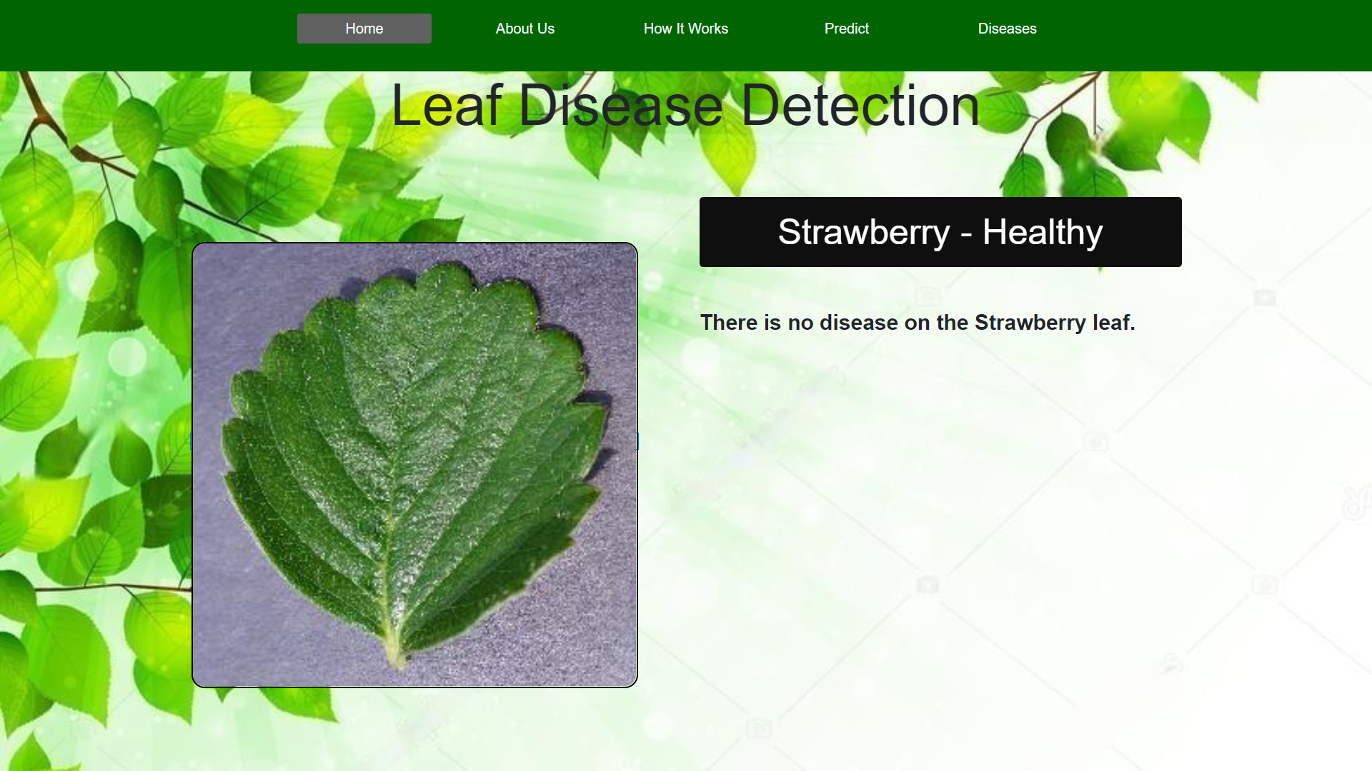
Snapshot of healthy leaf identification

Slide 27
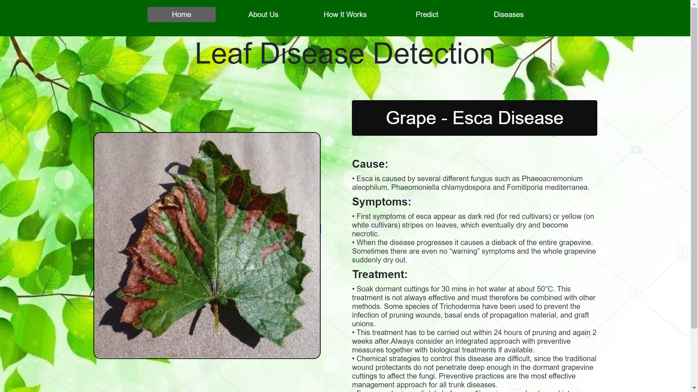
Snapshot of diseased leaf identification

Slide 28
CONCLUSION
By using the CNN algorithm leaf diseases are identified. Along with the disease name it also display the cause, symptoms and treatment for those concerned disease.
This model is much faster and has the accuracy of 95% in detecting the disease in leaves.

Slide 29
REFERENCES
[1] Asad Khattak, Muhammad Usama Asad Asghar, Ulfat Batool, Muhammad Zubair Asghar, Hayat Ullah, Mabrook Al-rakhami , (Member, Ieee), And Abdu Gumaei . “Automatic Detection of Citrus Fruit and Leaves Diseases Using Deep Neural Network Model”.
[2] Mobeen ahmad , Muhammad abdullah,Hyeonjoon moon, and Dongil han. “Plant Disease Detection in Imbalanced Datasets Using Efficient Convolutional Neural Networks With Stepwise Transfer Learning”.
[3] Peng Jiang, Yuehan Chen, Bin Liu, Dngjian He, And Chunquan Liang. “Real-Time Detection of Apple Leaf Diseases Using Deep Learning Approach Based on Improved Convolutional Neural Networks”.
[4] Uday pratap singh, Siddharth singh chouhan , Sukirty jain , and Sanjeev jain “Multilayer Convolution Neural Network for the Classification of Mango Leaves Infected by Anthracnose Disease”.

Slide 30




THANKS!
For Listening…

